Slide 1
British Airlines Review Analysis
Mohamad Ali Ghaddar

Slide 2
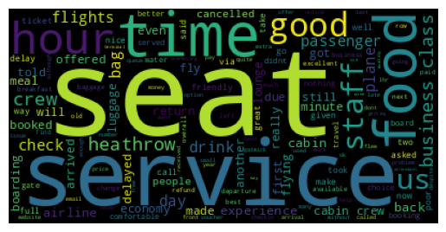
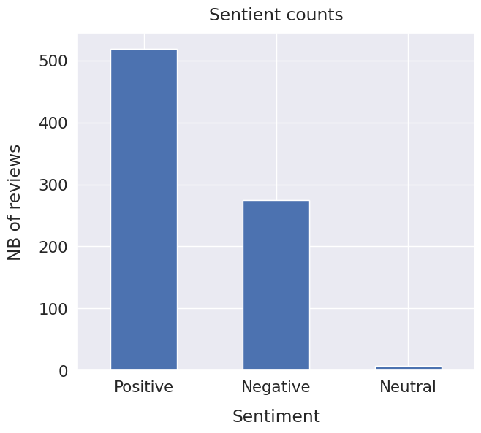
Analysis results: Reviews are mostly based heavily on seating, services, timing & food. Sentiment analysis provided us with mostly positive reviews, with almost doubled the negative reviews. We can deduce that we have mixed reviews that are mostly positive about our services, food, seating & flight timing, but also having many negative reviews also means that we should aim to get better in these sectors as well.

